Slide 1

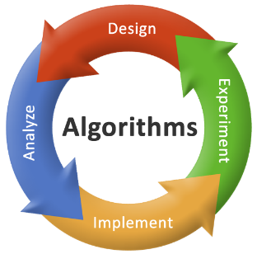
Computer Networks (CN) CTMTCSE SIV P2
Syllabus and Establishment of this Subject
Dr. Vijeta Khare

Slide 2
Syllabus and Books

Slide 3
CTMTCSE SIV P2: Computer Networks
Objectives
To learn about data communication
To learn about the network devices and its functionality.
To learn the services running on various network layers.
To learn the network topologies and their implementation.
To understand routing protocols.
Teaching Scheme |  |  |  |  | Evaluation Scheme
Th | Tu | Pr | C | TCH | Theory |  |  |  |  |  | Practical |  | Tot al
 |  |  |  |  | Internal Exams |  |  |  | University Exams |  | University Exams (LPW)
 |  |  |  |  | TA-1/TA-2 |  | MSE |  | Marks | Hrs. | Marks | Hrs.
 |  |  |  |  | Marks | Hrs. | Marks | Hrs.
03 | 00 | 00 | 03 | 03 | 25 | 00:45 | 50 | 01:30 | 100 | 03:00 | - | - | 200

Slide 4
UNIT – I
Data Communication
Data and Signals: Analog and Digital, Periodic Analog Signals, Digital Signals, performance, Digital Transmission: Digital to Digital and Analog to Digital Conversion, Transmission Modes, Analog Transmission. Bandwidth Utilization: Multiplexing, Spread Spectrum.
UNIT – II
History and Models
Introduction, history and development of computer networks and internet, various protocols and standards, network topologies, Network Categories: LAN, MAN, WAN, network reference model OSI and TCP/IP protocol suite.
UNIT – III
Physical and Link
Various transmission media (guided media and unguided media), wireless transmission media, errors in transmission: attenuation, noise. Repeaters. Data Link Layer: Error Detection & Correction Techniques, Elementary Data Link Layer Protocols: Simplex, Stop and Wait, Sliding Window Protocol.
UNIT – IV
Middle Layer
Medium Access Control sublayer: channel allocation problem, Multiple Access Protocols: ALOHA, CSMA, CSMA/CA, CSMA/CD, Ethernet, Data link layer switching, VLANs. Networking Devices (hub, switch, bridge, router, gateway, repeater), comparison of network devices, network core (packet switching, circuit switching).
UNIT – V
Network Layer
Types of Addressing, IPv4 and IPv6 Addressing scheme, Transition from IPv4 to IPv6, IP forwarding, classful and classless addressing (subnet, supernet), NAT, Basics of routing algorithms.

Slide 5
Reference Books
Computer Network by Andrew S. Tanenbaum and David J. Wetherall, 5th Edition
Computer Networking- A Top-Down approach (7th edition), Kurose and Ross, Pearson
Computer Networks- A Top-Down approach, Behrouz Forouzan, McGraw Hill
TCP/IP Protocol Suite (4th edition), Behrouz Forouzan, McGraw Hill
Data Communications and Networking By Behrouz A. Forouzan, 5th Edition

Slide 6
Assignment’s and practical’s
Are to be done yourself
You may discuss the assignments with other students
You may help (and get help with) debugging
You may not give your source code to anyone

Slide 7
Why you should study this course?
Because of Learning:
How data travel between computers
You will learn various networking technologies
Various protocol learning
Because of Importance of the subject:
Placement in few companies
Competitive Exams (7% of exam is covered from this subject)

Slide 8
Course Outcome
Understand the architecture of various networking technologies
Analyze the requirements of the organization and able to select the appropriate topology and structure of networks.
Have operational knowledge of managing the networks of organization.
Design the network for organization with better network efficiency parameters

Slide 9
Pre requisites for this course
Knowledge of a programming language: C or C++ and basic platform knowledge of Linux
You should be able to convert high level descriptive algorithm into a working program using C/C++ programming language
Knowledge of basic mathematics, such as: Basic Discrete mathematics

Slide 10

Unit 1

Slide 11
What is Computer Network?
Computer Network is a system in which multiple computers are connected to each other to share information and resources.
Network
Devices
Wireless
Computers
Wired

Slide 12


Advantages of Computer Network
File Sharing
Flexible Access
Entertainment
Better Communication

Slide 13
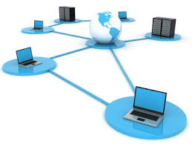
Advantages of Computer Network
Internet Access
Inexpensive System
Instant and Multiple Access
Resource Sharing

Slide 14




Applications of Computer Network
Email Services
Teleconferencing
Business & Finance
File & Directory Services
& Many More….

Slide 15
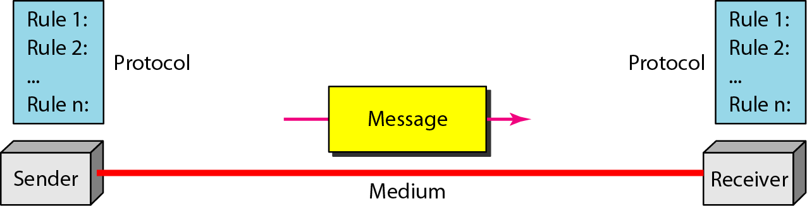
Five Components of Data Communication

Slide 16
Five Components of Data Communication
Message:
text, number, images, audio, and video
Sender and Receiver
devices that send/receive data message
Computer, workstation, telephone, TV, etc.
Transmission medium
Physical path thru which the message travels
Protocol
Set of rules governing data communications

Slide 17
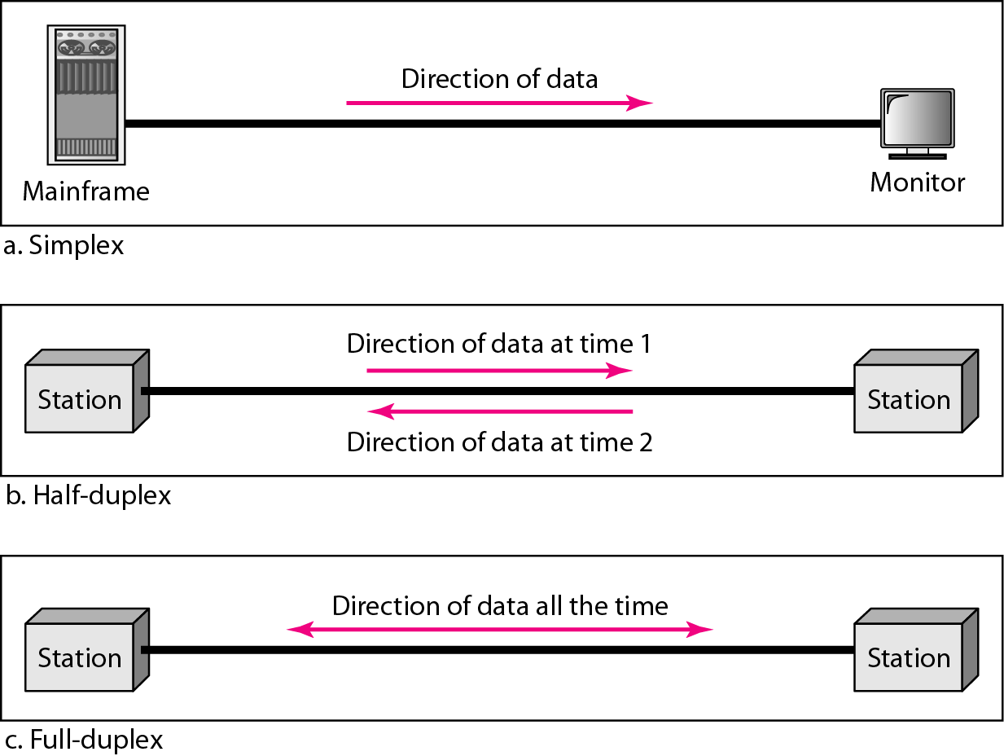
Data flow (simplex, half-duplex, and full-duplex)

Slide 18
Types of Computer Network
Computer networks can be categories by their size as well as their purpose.
The size of a network can be expressed by the geographic area.
Some of the different networks based on size are:
Local Area Network - LAN
Metropolitan Area Network - MAN
Wide Area Network - WAN

Slide 19

Local Area Network
A local area network (LAN) is a computer network that interconnects computers within a limited area such as a residence, school, laboratory, university campus or office building.

Slide 20
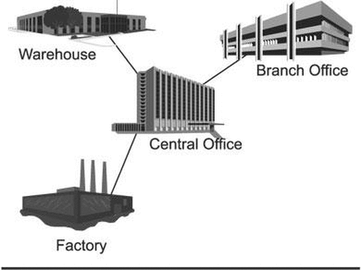
Metropolitan Area Network
A metropolitan area network (MAN) is a computer network that interconnects with computer in a metropolitan area like city.
MAN is a larger than LAN but smaller than the area covered by a WAN.
It is also used to interconnection of several local area network.
Navagam
Morbi
Rajkot
Shapar

Slide 21
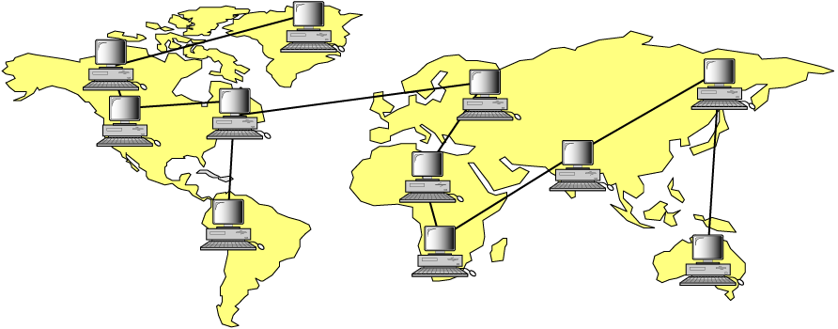
Wide Area Network
A wide area network (WAN) is a computer network that exists over a large-scale geographical area.
A WAN connects different networks, including local area networks (LAN) and metropolitan area networks (MAN).
It may be located with in a state or a country or it may be interconnected around the world.
Asia
America
Africa

Slide 22
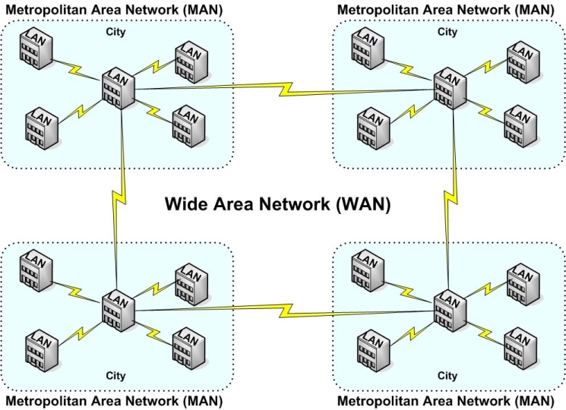
Types of Computer Networks - Summary

Slide 23
Types of Computer Networks - Summary
Basis Of Comparison | LAN | MAN | WAN
Full Name | Local Area Network | Metropolitan Area Network | Wide Area Network
Meaning | A network that connects a group of computers in a small geographical area | It covers relatively large region such as cities, towns | It spans large locality & connects countries together. e.g. Internet
Ownership of Network | Private | Private or Public | Private or Public (VPN)
Design and Maintenance | Easy | Difficult | Difficult
Propagation Delay | Short | Moderate | Long
Speed | High | Moderate | Low
Equipment Used | NIC, Switch, Hub | Modem, Router | Microwave, Radio Transmitter & Receiver
Range(Approximately) | 1 to 10 km | 10 to 100 km | Beyond 100 km
Used for | College, School, Hospital | Small towns, City | State, Country, Continent

Slide 24





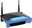




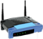


What is Internet?
The internet is a type of world-wide computer network.
The internet is the collection of infinite numbers of connected computers that are spread across the world.
Mobile Network
Network Components
Global ISP
PC
Home
Network
server
Regional ISP
wireless
links
wireless
laptop
Wired link
smartphone
router
Institutional
Network

Slide 25
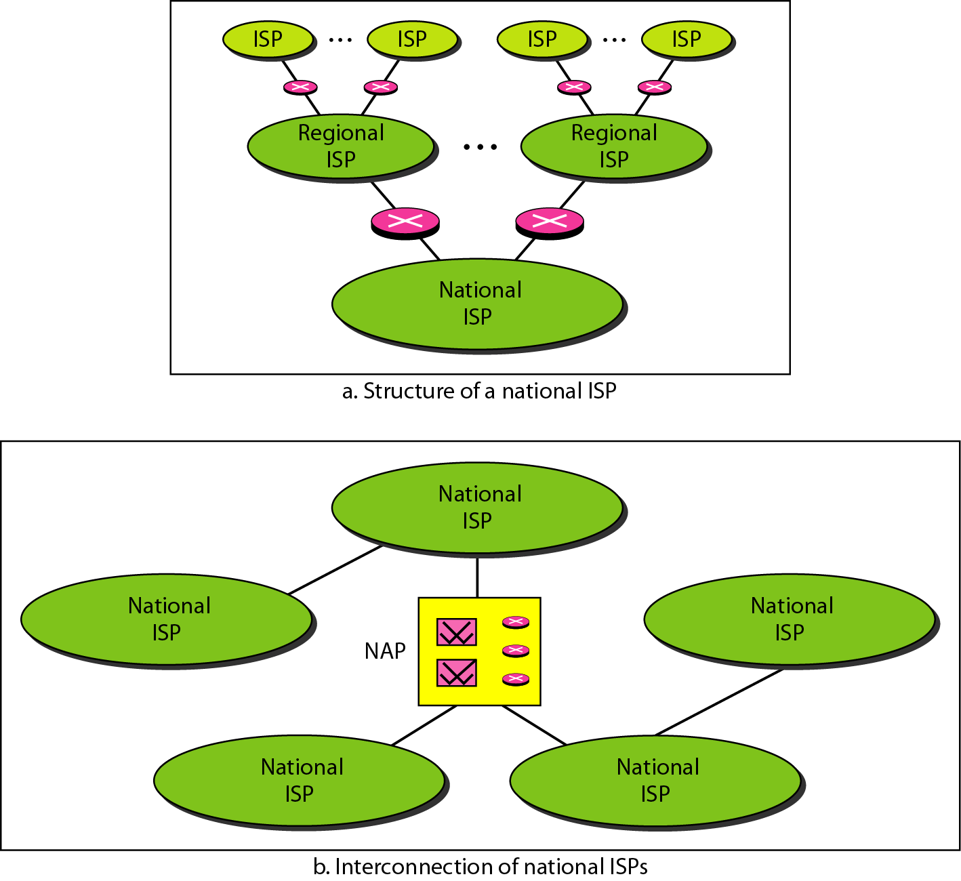
Hierarchical organization of the Internet

Slide 26
Intranet vs. Internet
Intranet
A private network that is contained within an enterprise
Could be LANs and WANs
Internet
A public network of networks
Both are using TCP/IP

Slide 27
Network edge

Slide 28


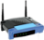

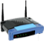


The Network Edge
Computers and other devices are connected at the edge (end) of the network.
These computers are known as hosts or end systems. Router is known as edge router.
mobile network
Global ISP
Home
Network
Regional ISP
Institutional
Network

Slide 29

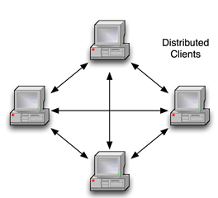

Peer to Peer Network
Computers are connected together so that users can share resources and information.
There is no central server for authenticating users, each of them works as both client and server.
e.g. Bit Torrent

Slide 30
Client – Server Network
Client: Request servers for a task.
Generally called desktop PCs or workstations.
Server: Receive requests from the clients. Process and response them.
e.g. Web Server, Email Server

Slide 31
Network core

Slide 32
The Network Core: Transmission Techniques
Defines the connection of different network segments together and process to transmit data across the network.
It is implemented through the use of switching techniques.
Switched
Networks
Circuit-Switched
Networks
Message-Switched
Networks
Packet-Switched
Networks

Slide 33
Circuit Switched Network
A dedicated channel has to be established before the call is made between users.
The channel is reserved between the users till the connection is active.
For half duplex(one way) communication, one channel is allocated and for full duplex(two way) communication, two channels are allocated.
It is mainly used for voice communication requiring real time services without delay.

Slide 34
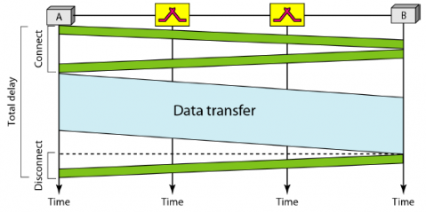
Circuit Switched Network – Cont…
Communication via circuit switching involves three phases:
Circuit Establishment
Data Transfer
Circuit Disconnect

Slide 35
Advantages:
After path is established, data communication without delay.
Very suitable for continuous traffic.
It establishes a dedicated path.
No overhead after call setup.
it is transparent and data passes in order.
Disadvantages:
Provide initial delay for setting up the call.
Inefficient for heavy traffic.
Data rate should be same because of fixed bandwidth.
When load increases, some calls may be blocked.
In data communication, traffic between terminal and server are not continuous. Sometimes more data may come or sometimes there is no data at all. Circuit switching is not efficient because of its fixed bandwidth.

Slide 36
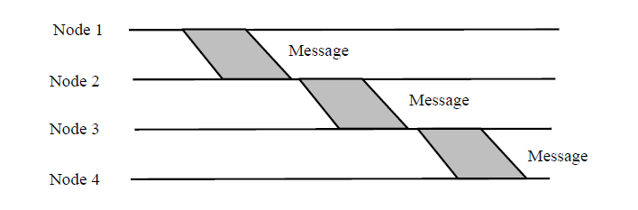
Message Switching
In this switching method, a different strategy is used, where instead of establishing a dedicated physical line between the sender and the receiver, the message is sent to the nearest directly connected switching node.
This node stores the message, checks for errors, selects the best available route and forwards the message to the next intermediate
The line becomes free again for other messages, while the process is being continued in some other nodes.
Due to the mode of action, this method is also known as store-and-forward technology where the message hops from node to node to its final destination.
Each node stores the full message, checks for errors and forwards it.

Slide 37
Basic idea:
Each network node receives and stores the message
Determines the next leg of the route, and
Queues the message to go out on that link.
Advantages:
Line efficiency is greater (sharing of links).
Data rate conversion is possible.
Even under heavy traffic, messages are accepted, possibly with a greater delay in delivery.
Message priorities can be used, to satisfy the requirements, if any.
Disadvantages: Message of large size monopolizes the link and storage

Slide 38
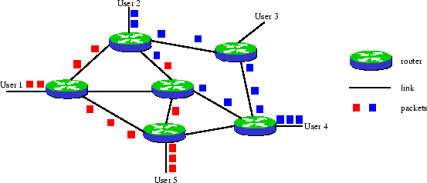
Packet Switched Network
It is not required to establish the connection initially.
The connection/channel is available to use by users. But when traffic or number of users increases then it will lead to congestion in the network.
Packet switched networks are mainly used for data and voice applications requiring non-real time scenarios.

Slide 39
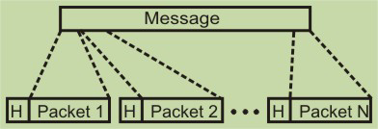
Packet Switching
The basic approach is not much different from message switching. It is also based on the same ‘store-and-forward’ approach.
However, to overcome the limitations of message switching, messages are divided into subsets of equal length called packets.
This approach was developed for long-distance data communication (1970) and it has evolved over time.
In packet switching approach, data are transmitted in short packets (few Kbytes).
A long message is broken up into a series of packets as shown in Fig. Every packet contains some control information in its header, which is required for routing and other purposes.

Slide 40
Advantages:
Call setup phase is avoided (for transmission of a few packets, datagram will be faster).
Because it is more primitive, it is more flexible.
Congestion/failed link can be avoided (more reliable).
Problems:
Packets may be delivered out of order.
If a node crashes momentarily, all of its queued packets are lost.

Slide 41
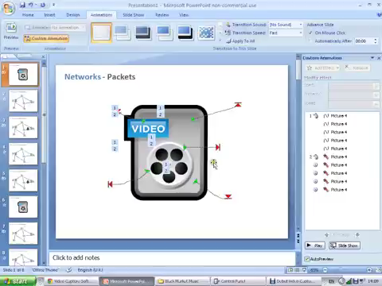
Switching Network

Slide 42
Delay, Loss & Throughput
Delay
As a packet travels from one node (host or router) to the subsequent node (host or router) along this path, the packet suffers from several types of delays at each node along the path.
Where
d_{nodal} = d_{proc} + d_{queue} + d_{tran} + d_{prop}
d_{nodal} | = | Total Delay
d_{proc} | = | Processing Delay
d_{queue} | = | Queuing Delay
d_{tran} | = | Transmission Delay
d_{prop} | = | Propagation Delay

Slide 43
Delay – Cont…
Processing Delay (d_{proc})
The time required to examine the packets header and determine where to direct the packet.
To check bit level error
Determine output link
Delay in terms of microseconds

Slide 44
Delay – Cont…
Queuing Delay (d_{queue})
A time to wait at output link for transmission.
Depends on congestion level of router.
If queue is empty then delay will be zero.
If queue is full (heavy traffic) then delay will be long.
Delay in terms of micro second to millisecond.

Slide 45
Delay – Cont…
Transmission Delay (d_{tran} = L/R)
An amount of time required for the router to transmit the packet.
Its depends on packet length(L) and transmission rate(R) of link.

Slide 46
Delay – Cont…
Propagation Delay (d_{prop}= d/s)
A time required to propagate from the beginning of the link to router B.
Depends on the length of physical medium(d) link and propagation speed(s) of link
Delay in terms of millisecond.

Slide 47
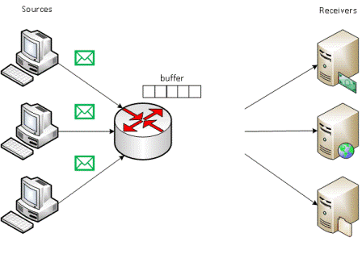
Packet Loss
Packet loss is the failure of one or more transmitted packets to arrive at their destination.
The loss of data packets depends on the switch queue/buffer. The loss of data packets increases with the increases in the traffic intensity.
It affects the performance
of the network.

Slide 48

Throughput
Throughput or Network Throughput is the rate of successful message delivery over a communication channel.
Throughput is measured in bits(data) per second (bit/s or bps)
server, with
file of F bits
send to client
link capacity
R_{s} bits/sec
link capacity
R_{c} bits/sec
Client

Slide 49
Network Topologies

Slide 50
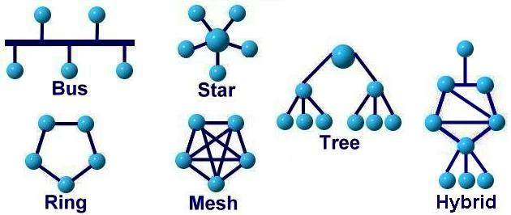
Network Topologies
Network topology is the arrangement of the various components(links, nodes, etc.) of a computer network.
Types of network topologies :
Bus
Ring
Star
Mesh
Tree
Hybrid

Slide 51
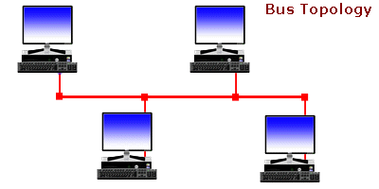
Bus Topology
Every computer and network device is connected to single cable
It transmits data only in one direction
Cost effective
Used in small networks
Easy to expand joining two cables together
It is used in early LAN connection

Slide 52
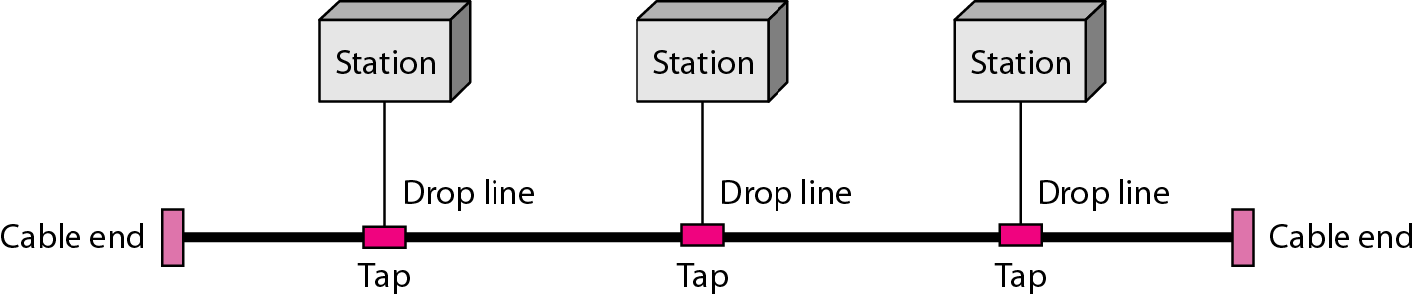
Bus Topology
Early Ethernet
Notes:
​ Bus topology is a network type in which every computer and network device is connected to single cable.
It transmits the data from one end to another in single direction. No bi-directional feature is in bus topology.

Slide 53
Advantages:
If N devices are connected to each other in bus topology, then the number of cables required to connect them is 1 ​which is known as backbone cable and N drop lines are required.
Cost of the cable is less as compared to other topology, but it is used to built small networks.
Disadvantages:
If the common cable fails, then the whole system will crash down.
If the network traffic is heavy, it increases collisions in the network.

Slide 54
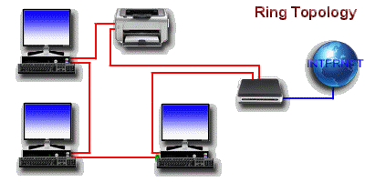
Ring Topology
It forms a ring as each computer is connected to another computer, with the last one connected to the first.
Transmission is unidirectional & sequential way that is bit by bit.
Transmitting network is not affected by high traffic or by adding more nodes, as only the nodes having tokens can transmit data.
Cheap to install and expand.

Slide 55
Advantages:
The possibility of collision is minimum in this type of topology.
Cheap to install and expand.
Disadvantages:
Troubleshooting is difficult in this topology.
Addition of stations in between or removal of stations can disturb the whole topology.

Slide 56
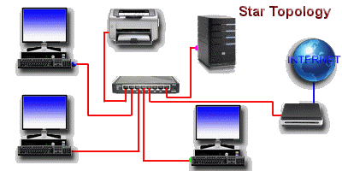
Star Topology
Computers are connected to a single central hub through a cable.
Fast performance with few nodes and low network traffic.
Easy to troubleshoot & Easy to setup and modify.
Only that node is affected which has failed rest of the nodes can work smoothly.
Hub can be upgraded easily.

Slide 57
Advantages:
If N devices are connected to each other in star topology, then the number of cables required to connect them is N. So, it is easy to set up.
Each device require only 1 port i.e. to connect to the hub.
Disadvantages:
If the concentrator (hub) on which the whole topology relies fails, the whole system will crash down.
Cost of installation is high.
Performance is based on the single concentrator i.e. hub.

Slide 58
Mesh Topology
Point-to-point connection to other devices or fully connected.
Traffic is carried only between two connected devices.
Robust, costly but not flexible.
Fault is diagnosed easily.
More cable resource used in setup.

Slide 59
Advantages:
It is robust.
Fault is diagnosed easily. Data is reliable because data is transferred among the devices through dedicated channels or links.
Provides security and privacy.
Disadvantages:
Installation and configuration is difficult.
Cost of cables are high as bulk wiring is required, hence suitable for less number of devices.
Cost of maintenance is high.

Slide 60
Tree Topology
It has a root node and all other nodes are connected to it forming a hierarchy.
Also called hierarchical topology.
Mostly used in Wide Area Network – WAN.
Expansion of nodes is possible and easy.
Easily managed and maintained.

Slide 61
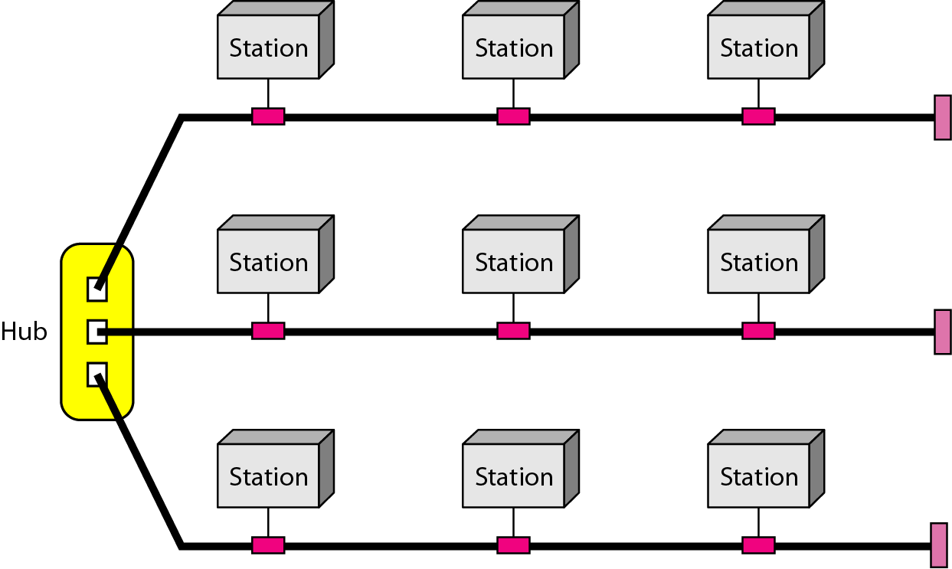
Hybrid Topology
A network structure whose design contains more than one topology is said to be hybrid topology.
It is a combination of two or more topologies.
Flexible & reliable as error detection and easy to troubleshoot.
Scalable as size can be increased easily.

Slide 62
Comparison of Topologies
 | Bus | Ring | Star | Mesh | Tree
Means | every computer and network device is connected to single cable. | Each computer is connected to another, with the last one connected to the first. | All the computers are connected to a single hub through a cable. | All the network nodes are connected to each other. | It has a root node and all other nodes are connected to it forming a hierarchy.
Cost | Average | Cheap | High | High | High
Used in | Small Network | Expand Network | Small Network | Expand Network | Expand Network
Troubleshoot | Easy, But Cables fail then whole network fails. | Difficult; Failure of one computer disturbs the whole network. | Easy; If the hub fails then the whole network is down. | Easy; Installation and configuration is difficult. | Easy; Central root hub fails, network fails.

Slide 63
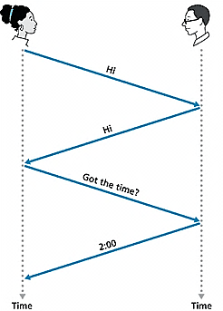
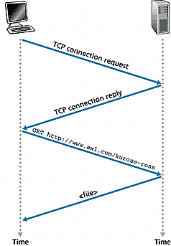
What is Protocol?
Human Protocol(Language)
“what’s the time?”
“I have a question”
Introduction Talk
Network Protocol
Set of rules
machines rather than humans
all communication activity in Internet governed by protocols.
Protocol is define format, order of message sent and received among network entities, and actions taken on message transmission and reception

Slide 64
Protocol Layers

Slide 65
Protocols Layers
To deals with connecting systems that are open for communication with other systems.
OSI Layer Model (Open Systems Interconnection)
Developed by the International Standards Organization (ISO) with seven different layers.
Physical Layer
Data Link Layer
Network Layer
Transport Layer
Session Layer
Presentation Layer
Application Layer

Slide 66
Example – Air Plane Travel
Departure
Arrival
ticket (purchase)
baggage (check)
gates (load)
runway takeoff
airplane routing
ticket (complain)
baggage (claim)
gates (unload)
runway landing
airplane routing
airplane routing

Slide 67
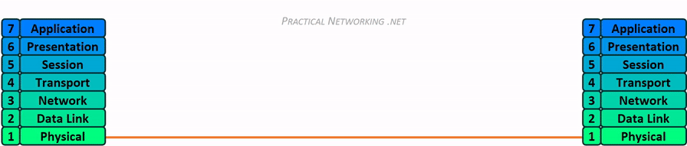
How OSI Layer Works?

Slide 68
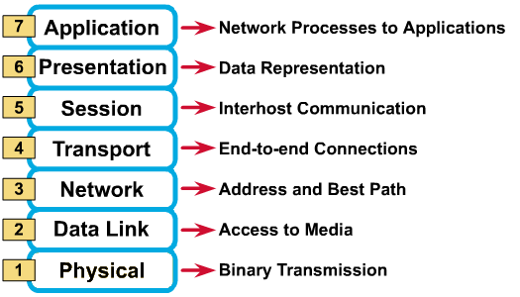
OSI Reference Model: 7 Layers
OSI Model

Slide 69
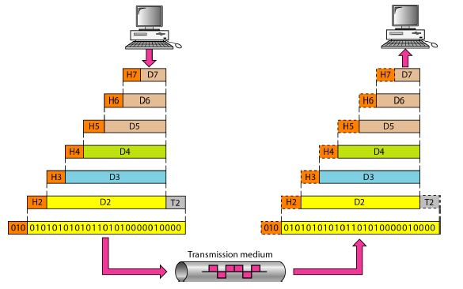
Exchange using OSI Model

Slide 70
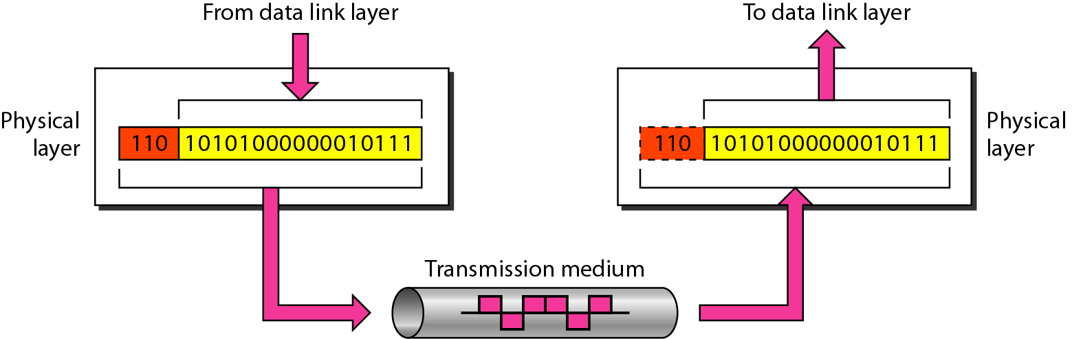
Physical Layer
The physical layer is responsible for movements of individual bits from one hop (node) to the next.

Slide 71
Physical Layer – Cont…
Carries the bit stream over a physical media.
Physical Layer is concerned with:
Interface and Medium like guided cables
Representation of bits
Data rate
Synchronization of bits
Line configuration
Physical topology
Transmission mode
Provides physical interface for transmission of information.
Defines rules by which bits are passed from one system to another on a physical communication medium.
Covers all - mechanical, electrical, functional and procedural - aspects for physical communication.
Such characteristics as voltage levels, timing of voltage changes, physical data rates, maximum transmission distances, physical connectors, and other similar attributes are defined by physical layer specifications.

Slide 72
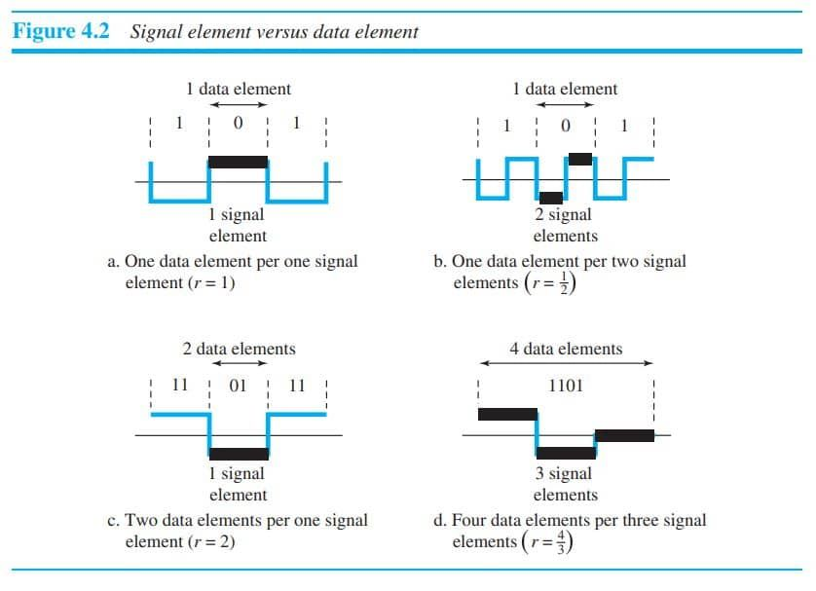
Bit rate and baud rate
The data rate defines the number of data elements (bits) sent in Is. The unit is bits per second (bps).
The signal rate is the number of signal elements sent in Is. The unit is the baud. There are several common terminologies used in the literature. The data rate is sometimes called the bit rate; the signal rate is sometimes called the pulse rate, the modulation rate, or the baud rate.

Slide 73
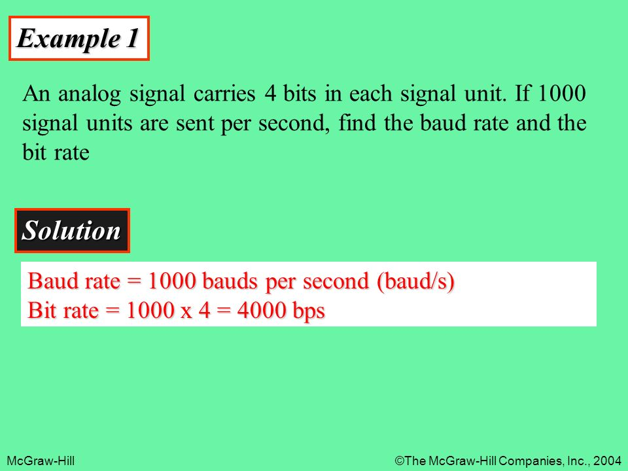

Slide 74
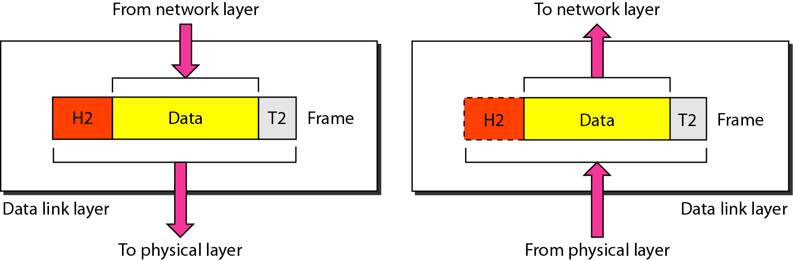
Data Link Layer
The data link layer is responsible for moving frames from one hop to the next.

Slide 75
Data Link Layer – Cont…
Data link layer is concerned with:
Framing – divide bits stream into data unit (frame)
Physical addressing
Flow control – avoid over overwhelming
Error control – bit loses, retransmission
Access control
Data link layer attempts to provide reliable communication over the physical layer interface.
Breaks the outgoing data into frames and reassemble the received frames.
Create and detect frame boundaries.
Handle errors by implementing an acknowledgement and retransmission scheme.
Implement flow control.
Supports points-to-point as well as broadcast communication.
Supports simplex, half-duplex or full-duplex communication.

Slide 76
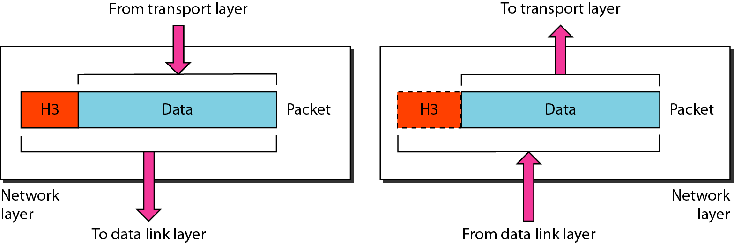
Network Layer
The network layer is responsible for the delivery of individual packets from the source host to the destination host.

Slide 77
Network Layer – Cont…
In this layer, packet is combined with header and data.
In case of data link layer, packet delivers on the same network.
If two different networks are connected then packet is concern with network layer.
Network layer is concerned with:
Logical addressing e.g. 192.168.1.1 (IP Address)
Routing

Slide 78
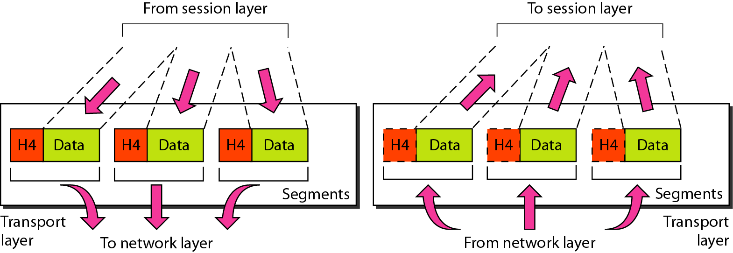
Transport Layer
The transport layer is responsible for the delivery of a message from one process to another.

Slide 79
Transport Layer – Cont…
This layer ensures that the whole message arrives intact and in order.
Transport layer is concerned with:
Service-point addressing (port address)
Segmentation and reassembly
Connection control
Flow and error control

Slide 80
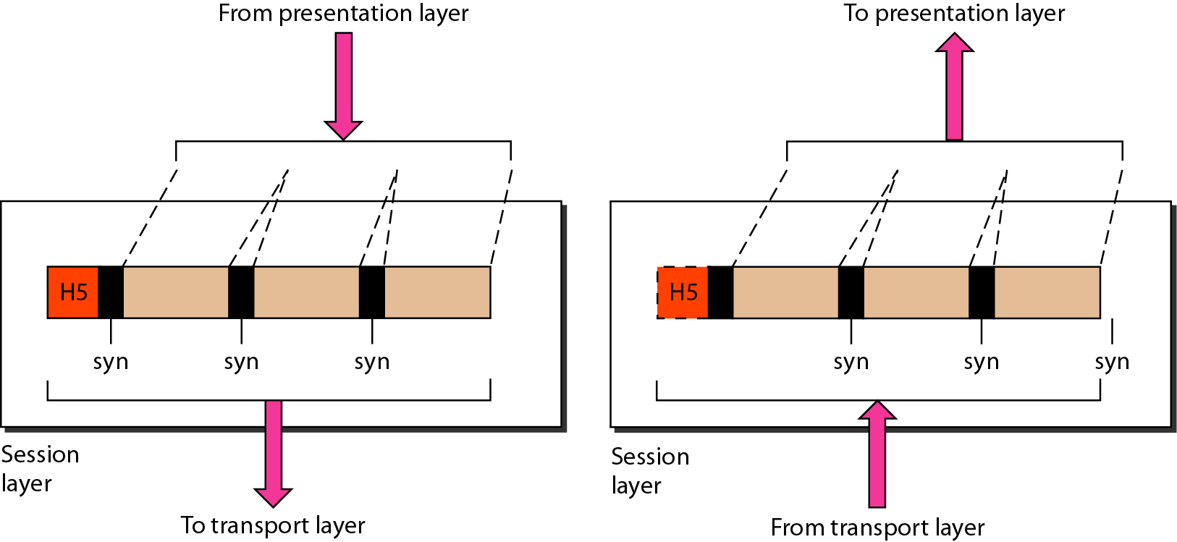
Session Layer
The session layer is responsible for dialog control and synchronization.

Slide 81
Session Layer – Cont…
This layer is network dialog controller – establishes, maintains, synchronizes the interaction among computers.
Session layer is concerned with:
Dialog control
Synchronization

Slide 82
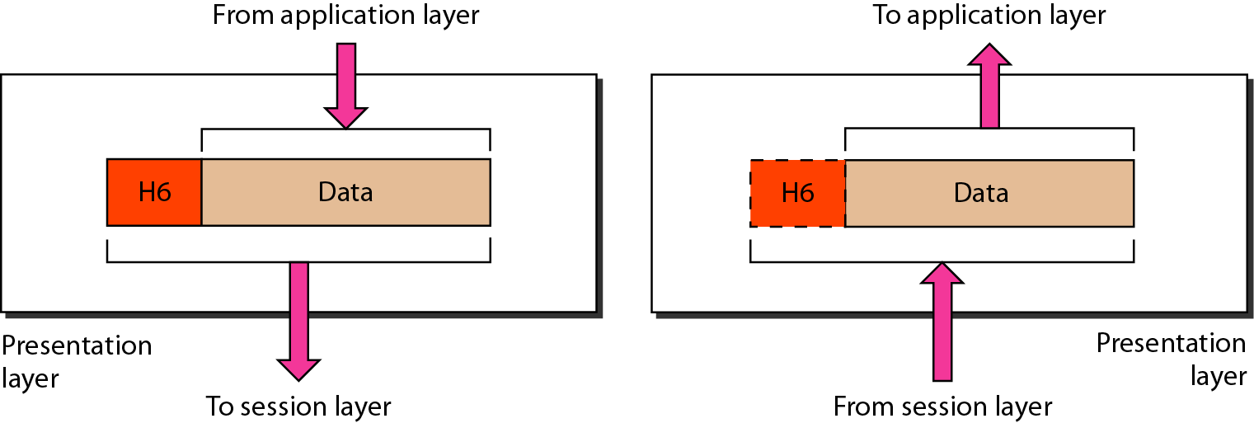
Presentation Layer
The presentation layer is responsible for translation, compression, and encryption.

Slide 83
Presentation Layer – Cont…
This layer is concerned with the syntax which refers to order in which data is presented and semantics helps in interpreting a particular pattern.
Presentation layer is responsible for:
Translation
Encryption
Compression

Slide 84
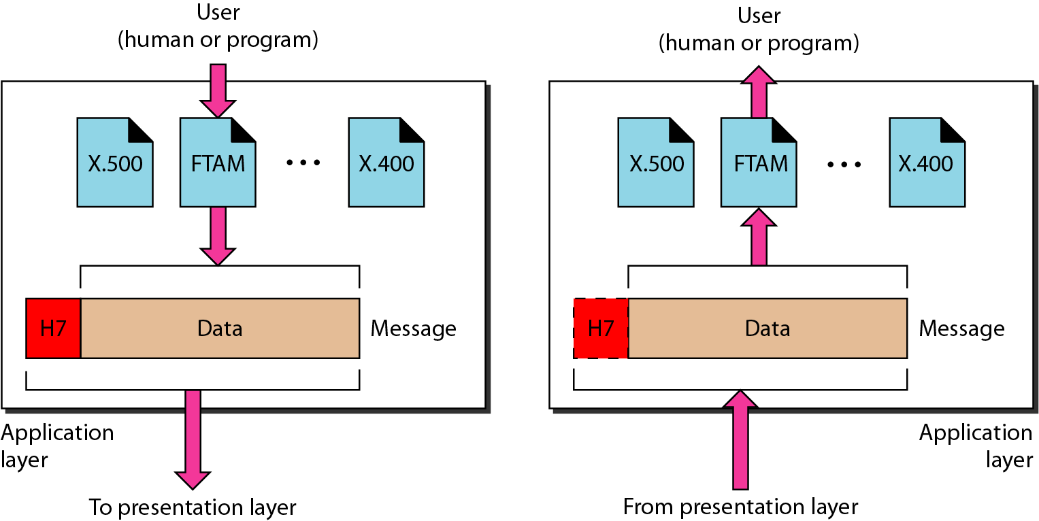
Application Layer
The application layer is responsible for providing services to the user.

Slide 85
Application Layer – Cont…
This layer provides various services like:
Network virtual terminal
File transfer, access and management
Mail services
Directory services

Slide 86
Summary – OSI Layer
To allow access to network resource
Application
To translate, encrypt and compress data
Presentation
To establish, manage and terminate sessions
To provide reliable process-to-process message delivery and error recovery
Session
Transport
To move packets from source to destination; To provide internetworking
Network
To organize bits into frames; To provide hop-to-hop delivery
Data link
To transmit bits over a medium; To provide mechanical & electrical specification
Physical

Slide 87
TCP/IP Reference Model (Transmission Control Protocol/Internet Protocol)
It was originally defined as having five layers:
TCP/IP is a set of protocols developed to allow cooperating computers to share resources across the network.
Application Layer
Transport Layer
Network Layer
Data Link Layer
Physical Network

Slide 88
TCP/IP Model Architecture

Slide 89
Difference
OSI (Open System Interconnection) | TCP/IP (Transmission Control Protocol/ Internet Protocol)
It has 7 layers | It has 5 layers
OSI provides layer functioning and also defines functions of all the layers | TCP/IP model is more based on protocols and protocols are not flexible with other layers
In OSI model the transport layer guarantees the delivery of packets | In TCP/IP model the transport layer does not guarantees delivery of packets
Follows horizontal approach | Follows vertical approach
OSI model has a separate presentation layer | TCP/IP doesn’t have a separate presentation layer
OSI is a general model | TCP/IP model cannot be used in any other application

Slide 90
Difference - Cont…
OSI (Open System Interconnection) | TCP/IP (Transmission Control Protocol/ Internet Protocol)
Network layer of OSI model provide both connection oriented and connectionless service | The Network layer in TCP/IP model provides connectionless service
OSI model has a problem of fitting the protocols in the model | TCP/IP model does not fit any protocol
Protocols are hidden in OSI model and are easily replaced as the technology changes | In TCP/IP, replacing protocol is not easy
OSI model defines services, interfaces and protocols very clearly and makes clear distinction between them | In TCP/IP, it is not clearly separated its services, interfaces and protocols

Slide 91
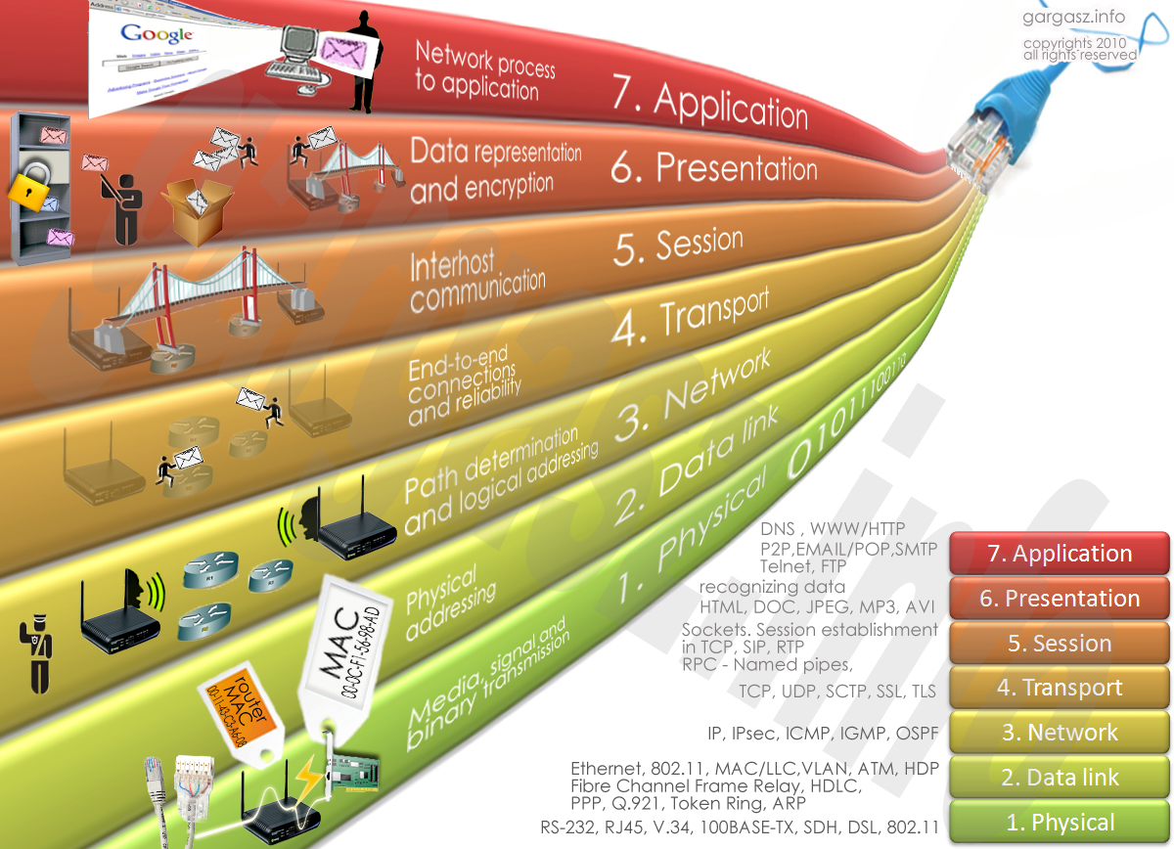
Protocol Layers: Summary

Slide 92
Thank You

